Slide 1
Chapter 9
One- and Two-Sample Estimation Problems

Slide 2
Section 9.1
Introduction

Slide 3
Section 9.2
Statistical Inference

Slide 4
Section 9.3
Classical Methods of Estimation

Slide 5
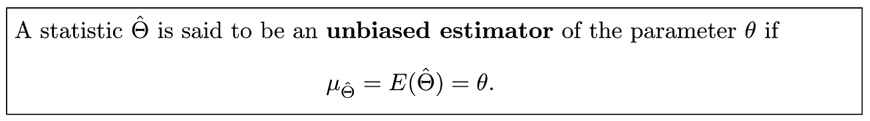
Definition 9.1

Slide 6
Definition 9.2

Slide 7
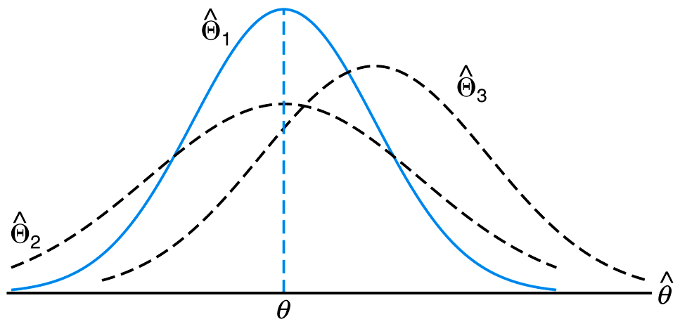
Figure 9.1 Sampling distributions of different estimators of θ

Slide 8
Section 9.4
Single Sample: Estimating the Mean

Slide 9
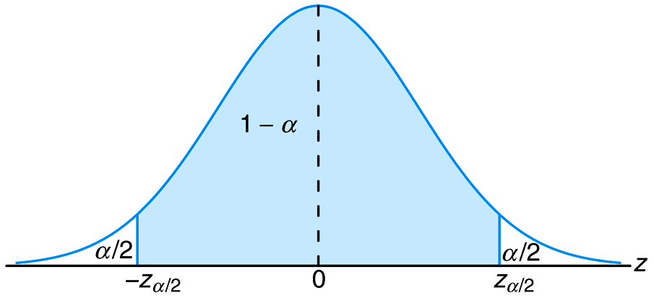
Figure 9.2 P(-z_{α/2} < Z < z_{α/2}) = 1-α

Slide 10
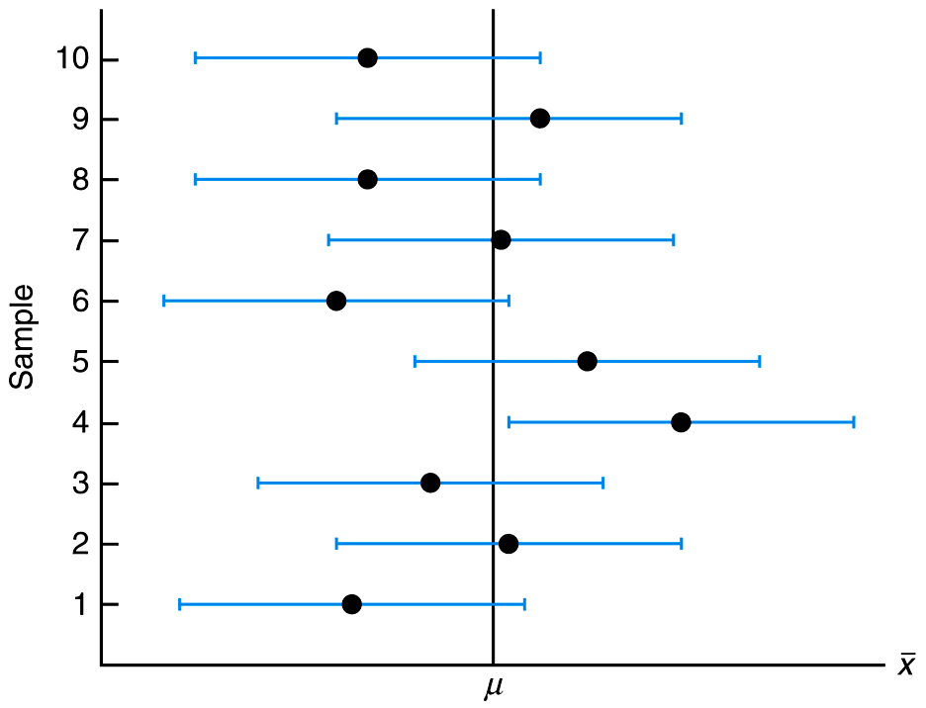
Figure 9.3 Interval estimates of μ for different samples

Slide 11
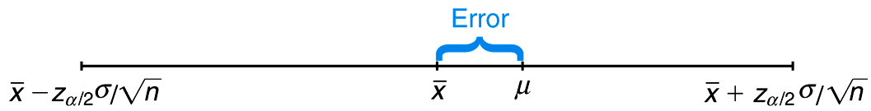
Figure 9.4 Error in estimating μ by x
_

Slide 12
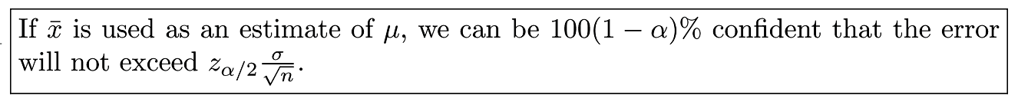
Theorem 9.1

Slide 13
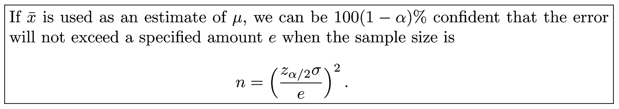
Theorem 9.2

Slide 14
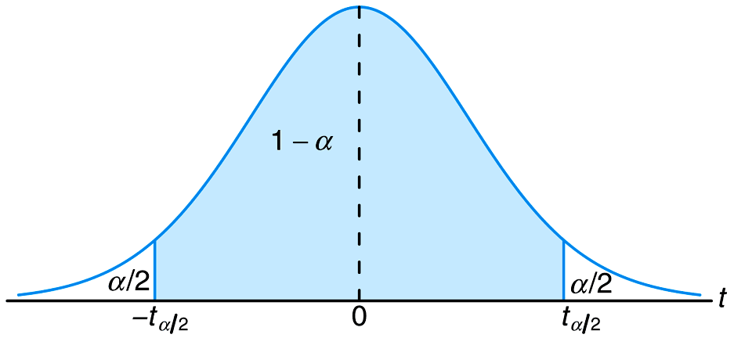
Figure 9.5 P(−t_{α /2} < T < t_{α /2}) = 1−α

Slide 15
Section 9.5
Standard Error of a Point Estimate

Slide 16
Section 9.6
Prediction Intervals

Slide 17
Section 9.7
Tolerance Limits

Slide 18
Section 9.8
Two Samples: Estimating the Difference between Two Means

Slide 19
Section 9.9
Paired Observations

Slide 20
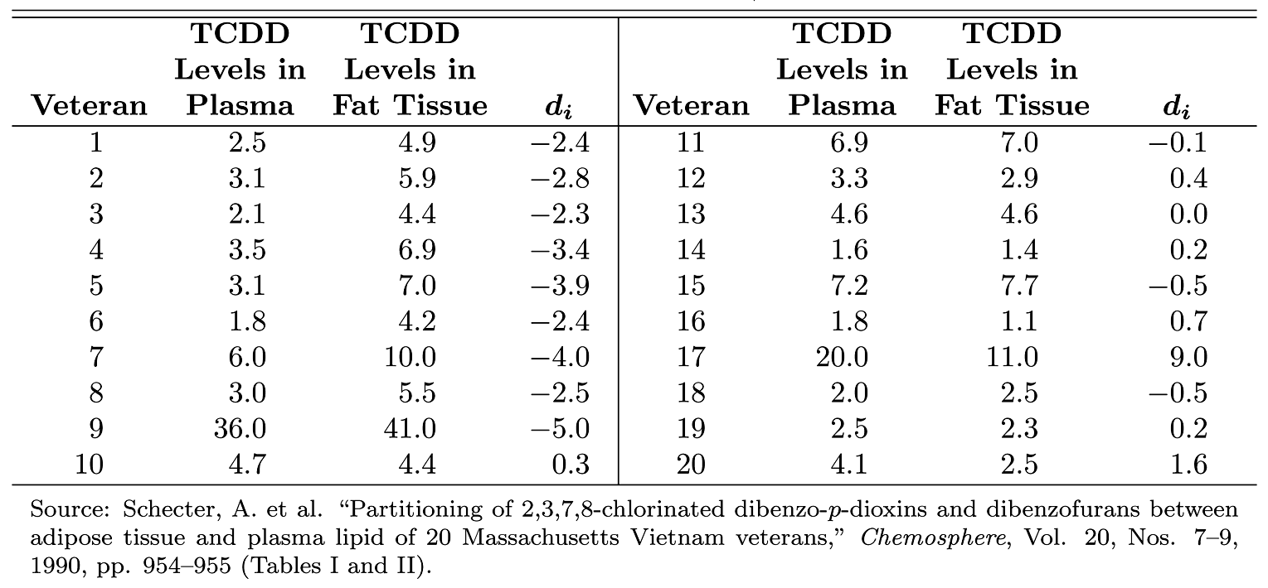
Table 9.1 Data for Example 9.13

Slide 21
Section 9.10
Single Sample: Estimating a Proportion

Slide 22

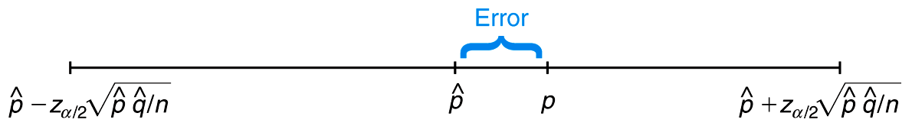
Figure 9.6 Error in estimating p by

Slide 23
Theorem 9.3

Slide 24
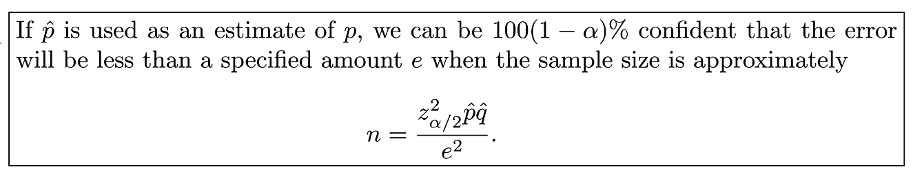
Theorem 9.4

Slide 25
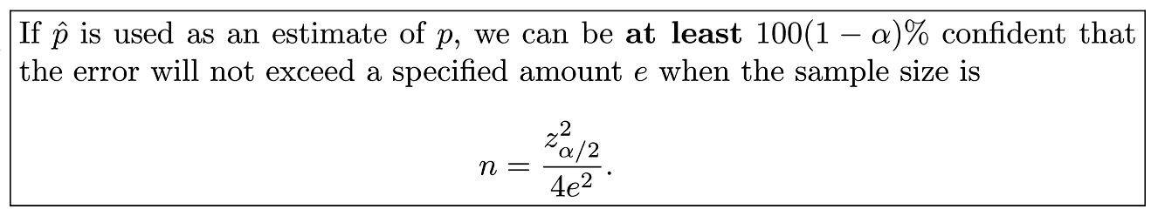
Theorem 9.5

Slide 26
Section 9.11
Two Samples: Estimating the Difference between Two Proportions

Slide 27
Section 9.12
Single Sample: Estimating the Variance

Slide 28
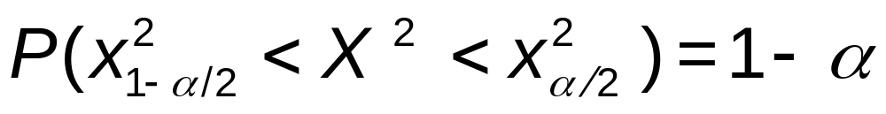
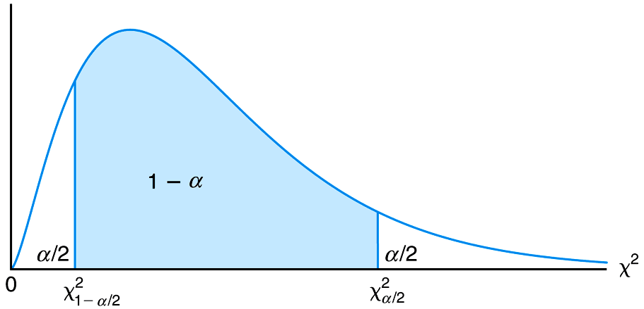
Figure 9.7

Slide 29
Section 9.13
Two Samples: Estimating the Ratio of Two Variances

Slide 30
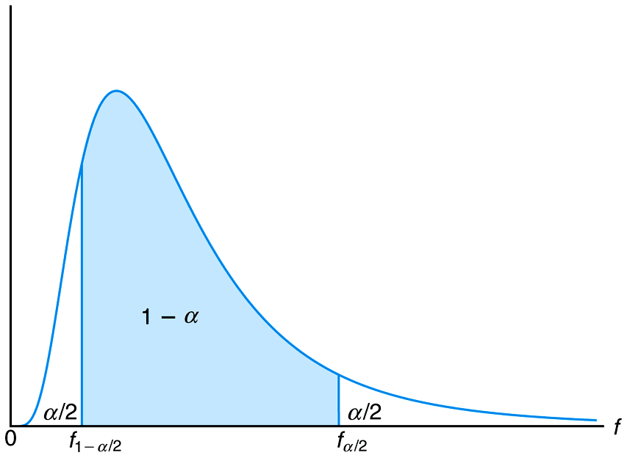
Figure 9.8

Slide 31
Section 9.14
Maximum Likelihood Estimation (Optional)

Slide 32
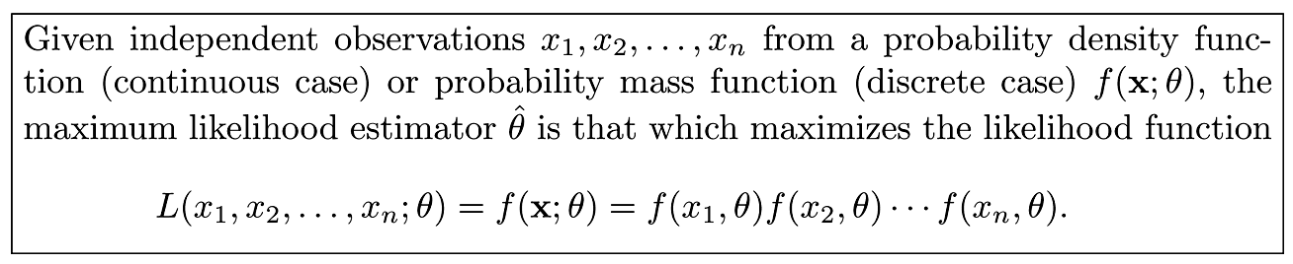
Definition 9.3

Slide 33
Section 9.15
Potential Misconceptions and Hazards; Relationship to Material in Other Chapters

